Slide 1



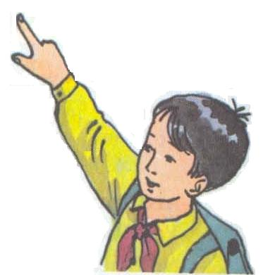
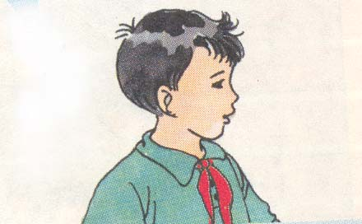
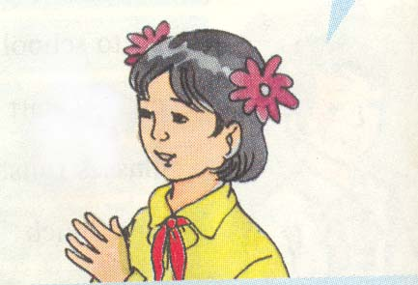

Welcome to our class!
6A

Slide 2
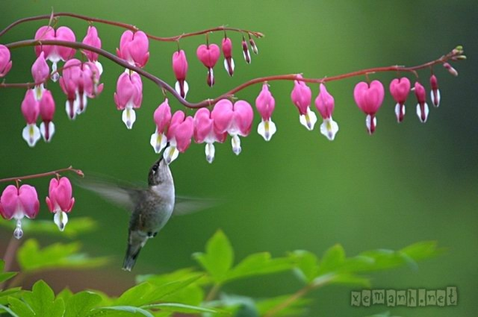

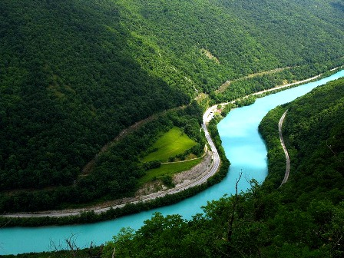
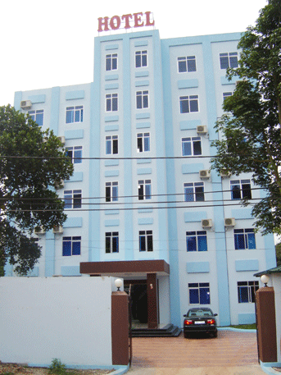
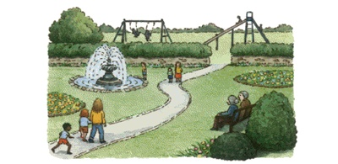

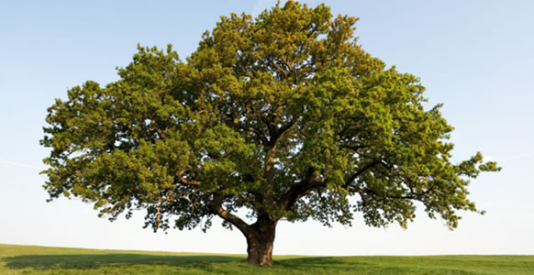
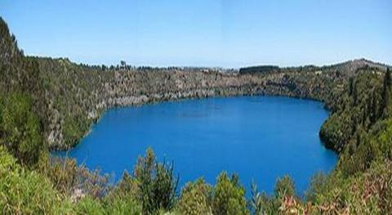
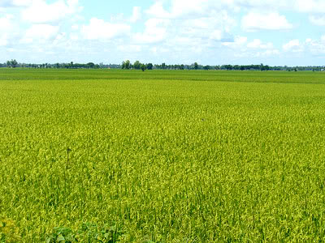

house
river
hotel
park
flowers
tree
lake
rice paddy
school

Slide 3
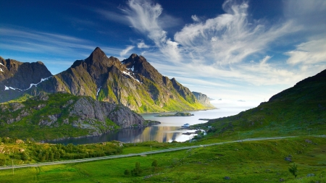
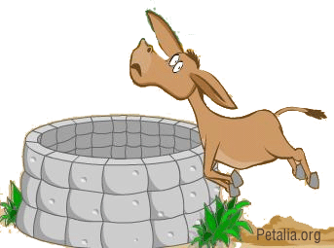
Unit 6 : Lesson 4

Slide 4
Unit 6 : Lesson 4
1. in front of
a. cái giếng
2. behind
b. phía bên trái
3. to the left of
c. phía sau
4. to the right of
d. ngọn núi
5. between
e. phía trước
6. a well
f. phía bên phải
7. a mountain
h. ở giữa

Slide 5
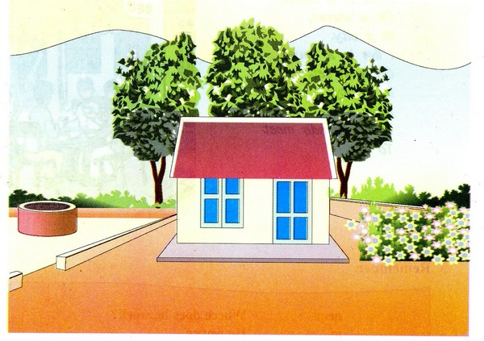
Unit 6 : Lesson 4

Slide 6
Unit 6 : Lesson 4

Slide 7
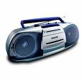
Unit 6 : Lesson 4

Slide 8
Unit 6 : Lesson 4
Answer the questions:
Where is the yard?
Where are the tall trees?
Where are the mountains?
Where is the well?
Where are the flowers?
Where is the house?

Slide 9
Lucky numbers
2
B
A
1
3
4
5
6
7
9
8

Slide 10
Where is the yard?
It is in front of the house.

Slide 11
Where are the tall trees?
They are behind the house.

Slide 12
Where are the mountains?
They are behind the tall trees.

Slide 13
Where is the well?
It is to the left of the house.

Slide 14
Where are the flowers?
They are to the right of the house.

Slide 15
Where is the house?
It is between the well and the flowers.

Slide 16
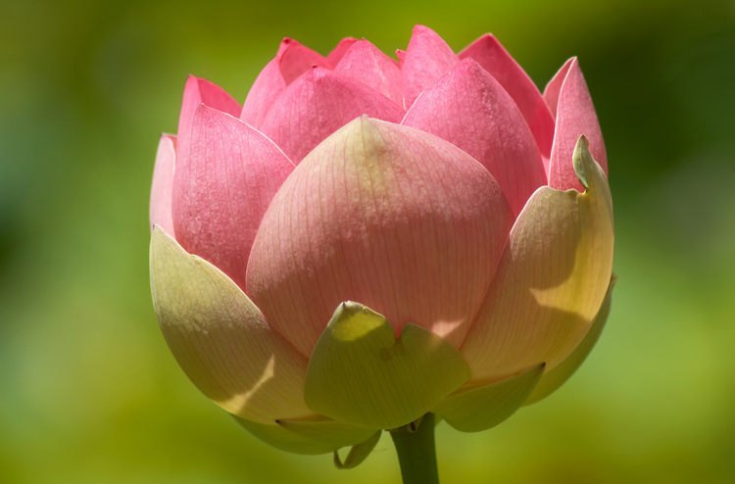
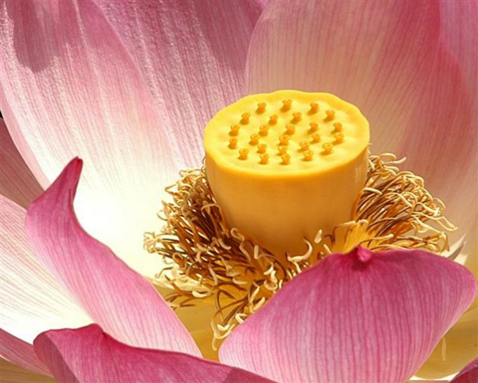
Lucky number

Slide 17
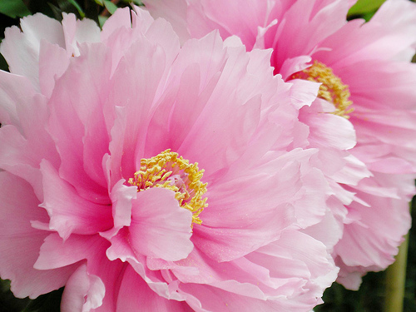
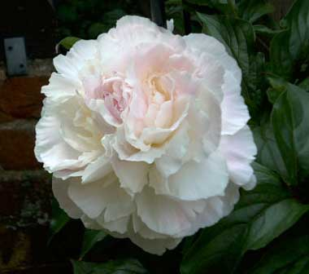
Lucky number

Slide 18

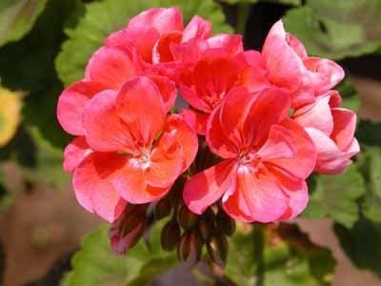
Lucky number

Slide 19
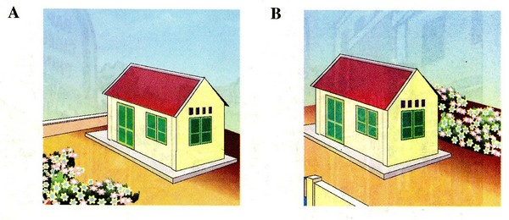
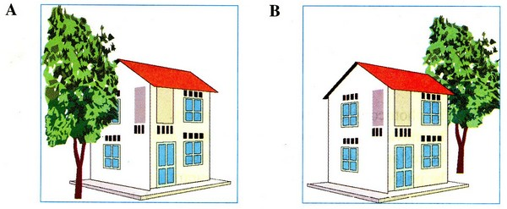
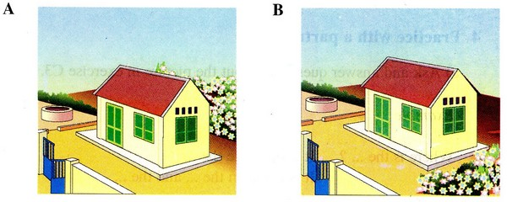
a) Which is Ba’s house?
A
B
A
B
b) Which is Lan’s house?
B
A
c) Which is Tuan’s house?

Slide 20

a) Which is Ba’s house?
A
There are a lot of flowers in front of the house.
b) Which is Lan’s house?
B
There are tall trees to the right of Lan’s house.
c) Which is Tuan’s house?
B
There is a well to the left of the house and
there are some flowers to the right.

Slide 21

Exercise: Complete the text below with suitable words or phrases.
Look at the house.
(1)……… . of the house, there is a big (2)…….. . .
In front
yard
Behind the house, there are tall trees.
Behind
mountains.
(3) ……….. the tall trees, there are (4) ………....
left
well.
To the (5)…… of the house, there is a (6) …….
right
To the (7) ……..of the house, there are (8) ……
flowers.

Slide 22
Homework
- Learn the new words.
- Write 5 sentences describing around your house.
- Prepare the new lesson. (C3,C4)

Slide 23


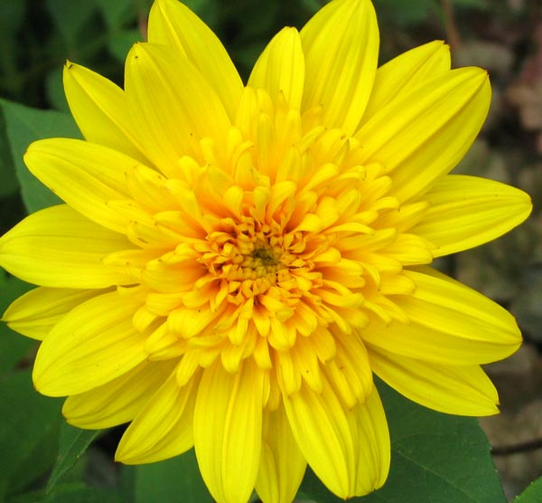

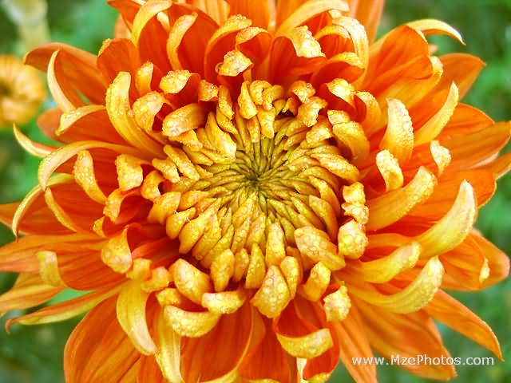
Goodbye

